Slide 1
Unit 1
Fundamentals of DC circuits

Slide 2
Basic Definitions
Voltage or Potential difference is the difference in charge between two points. It is measured in Volts.
Current is the rate at which charge is flowing or simply called as flow of charge. It is measured in Amperes.
Resistance is a material's tendency to resist the flow of charge (current). It is measured in Ohms.
Energy is defined as the amount of work that can be performed by force, whereas power is defined as the rate at which work is performed.

Slide 3
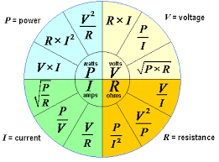
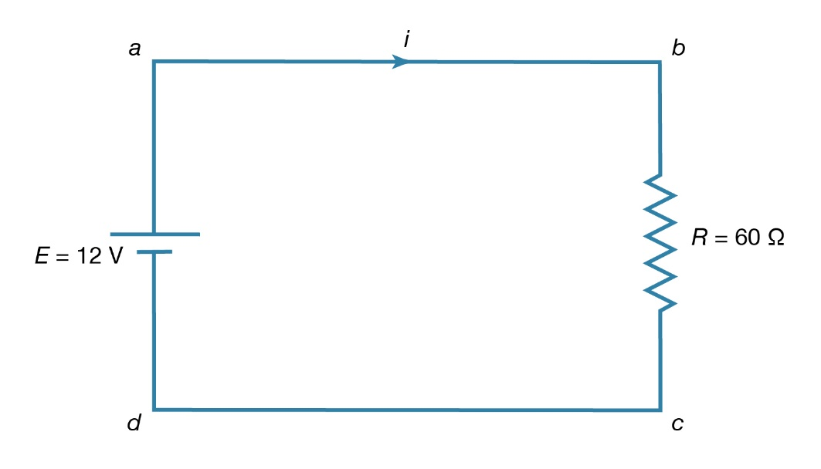
Fundamentals of D.C. circuits
An electric circuit is an interconnection of electrical elements
D.C. circuits means Direct Current Circuit

Slide 4
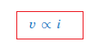
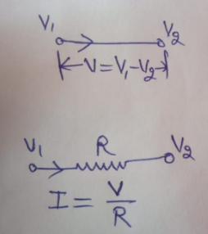
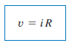
Ohm’s Law
Given by Georg Simon Ohm (1787–1854), a German physicist
finding the relationship between current and voltage for a resistor. This relationship is known as Ohm’s law.
Statement: Ohm’s law states that the voltage v across a resistor is directly proportional to the current i flowing through the resistor.
Mathematically,
This is the mathematical form of Ohm’s law

Slide 5
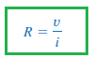
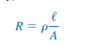
Applications of Ohm’s Law
1. To find unknown Voltage (V)
2. To Find unknown Resistance (R)
3. To Find unknown Current (I)
4. Can be used to find Unknown Conductance (G)=1/R
5. Can be used to find unknown Power (P)=VI
6. Can be used to find unknown conductivity or Resistivity

Slide 6
Poll 1
Q.1 An electric iron draws 2 A at 120 V. Find its resistance.
Q.2 The essential component of a toaster is an electrical element (a resistor) that converts electrical energy to heat energy. How much current is drawn by a toaster with resistance 15 ohm at 110 V?
40 ohms, 2 Ampere
60 ohms, 7.33 Ampere
20 ohms 8 Ampere
100 ohms 10 Ampere

Slide 7
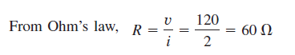
Solution:
Solution: I=V/R=110/15=7.333A

Slide 8
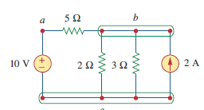
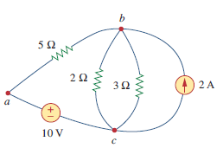
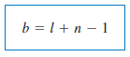
Nodes, Branches, and Loops
BRANCH: A branch represents a single element such as a voltage source or a resistor.
NODE: A node is the point of connection between two or more branches.
LOOP: A loop is any closed path in a circuit.
A network with b branches, n nodes, and l independent loops will satisfy the fundamental theorem of network topology:

Slide 9
Kirchhoff’s Laws
First introduced in 1847 by the German physicist Gustav Robert Kirchhoff

Slide 10
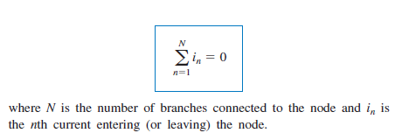
Kirchhoff’s Current Law (KCL)
Kirchhoff’s current law (KCL) states that the algebraic sum of currents
entering a node (or a closed boundary) is zero.
Mathematically, KCL implies that

Slide 11
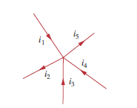
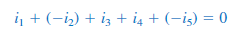
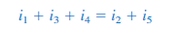
Sign Convention for KCL: Entering Current: Taken as +ve Leaving Current: Taken as -ve
The sum of the currents entering a node is equal to the sum of the currents leaving the node.

Slide 12
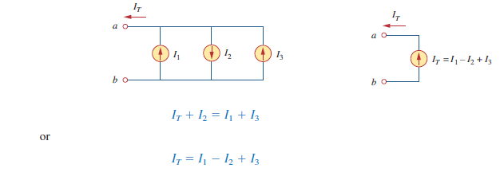
Example for KCL

Slide 13
Poll 2 Q. KCL is based on the fact that a) There is a possibility for a node to store energy. b) There cannot be an accumulation of charge at a node. c) Charge accumulation is possible at node d) Charge accumulation may or may not be possible.

Slide 14
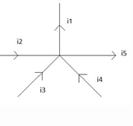
Poll 3
Q. Relation between currents according to KCL is
a) i₁=i₂=i₃=i₄=i₅ b) i₁+i₄+i₃=i₅+i₂ c) i₁-i₅=i₂-i₃-i₄ d) i₁+i₅=i₂+i₃+i₄

Slide 15
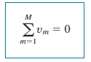
Kirchhoff’s Voltage Law (KVL)
Kirchhoff’s voltage law (KVL) states that the algebraic sum of all voltages around a closed path (or loop) is zero.
mathematically, KVL states that

Slide 16
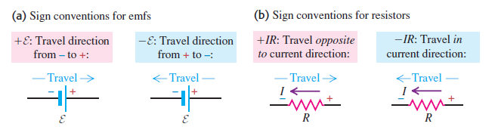
Sign Convention for KVL
KVL can be applied in two ways:
1. By taking either a clockwise or a counterclockwise trip around the loop.
2. By the algebraic sum of voltages around the loop is zero.

Slide 17
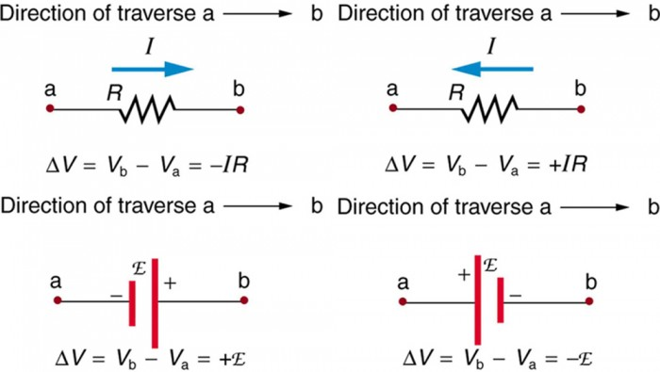
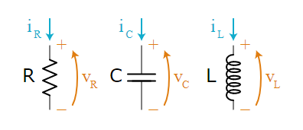
Sign Convention of KVL for R, L and C

Slide 18
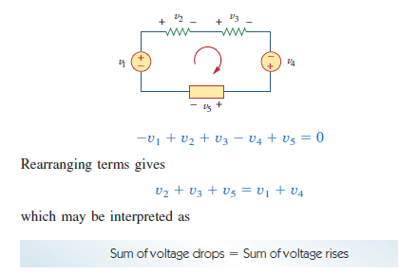
Example-1 for KVL

Slide 19
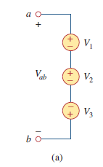
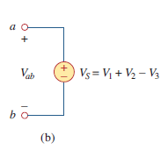
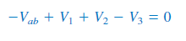
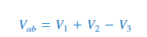
Example-2 for KVL
Sum of voltage rises=Sum of voltage drops
Equivalent Circuit

Slide 20
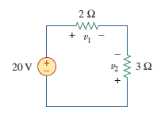
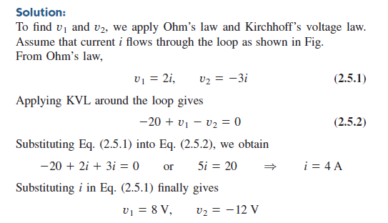
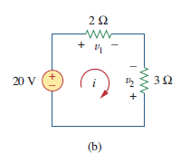
Example-3 for KVL For the circuit in Fig.1(a), find voltages v1 and v2.

Slide 21
Q. The algebraic sum of voltages around any closed path in a network is equal to ___ a) Infinity b) 1 c) 0 d) Negative polarity
Poll 4

Slide 22
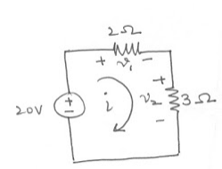
Find out V₁ and V₂ using KVL
Poll 5
a) 8V, 12V b) 5V, 6V c) 6V, 7V d) 7V, 8V

Slide 23
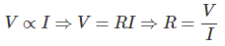
Resistance
Resistance (also known as ohmic resistance or electrical resistance) is a measure of the opposition to current flow in an electrical circuit. Resistance is measured in ohms, symbolized by the Greek letter omega (Ω).
When a voltage is applied across a substance there will be an electric current through it. The applied voltage across the substance is directly proportional to the current through it. The constant of proportionality is resistance. Hence resistance is defined as the ratio of applied voltage to the current through the substance.

Slide 24
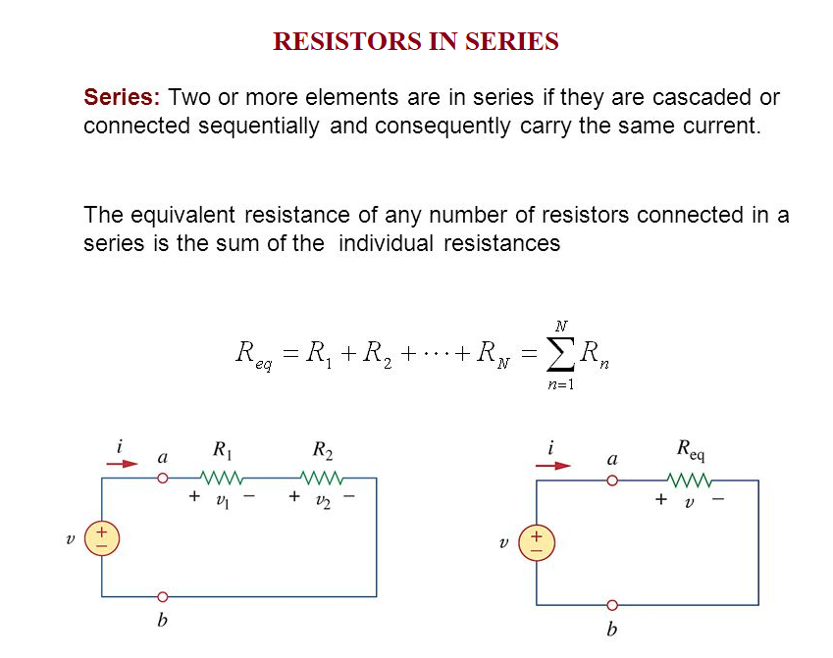
Note: Resistors in series behave as a single resistor whose resistance is equal to the sum of the resistances of the individual resistors.

Slide 25
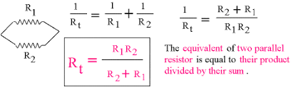
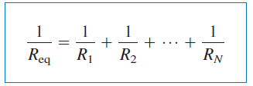
Resistors in Parallel The equivalent resistance of two parallel resistors is equal to the product of their resistances divided by their sum.

Slide 26
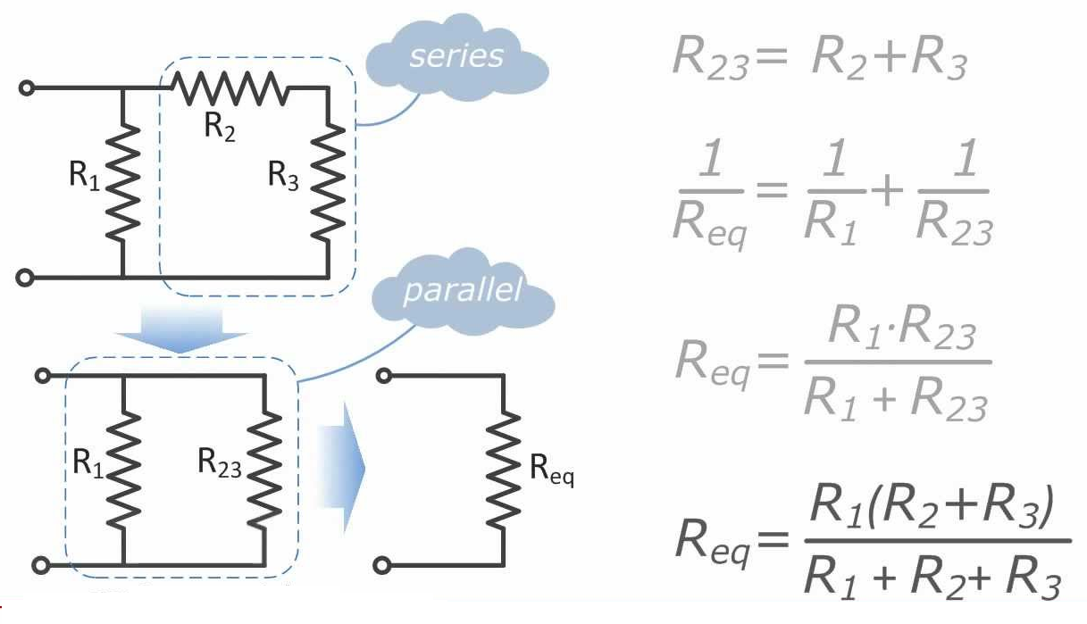
How to find Equivalent Resistance for Series-Parallel Combinations

Slide 27
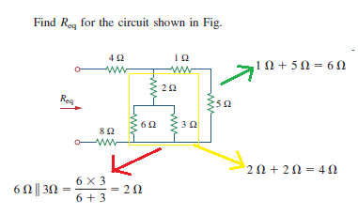
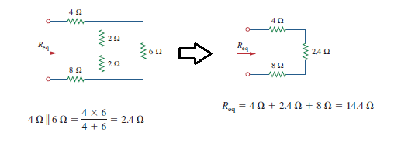
Example: To find Req

Slide 28
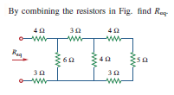
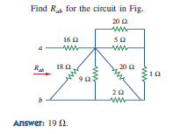
Practice Problem to find Equivalent Resistance

Slide 29
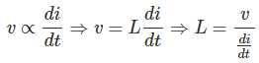
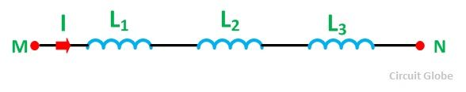
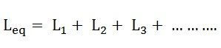
Inductance
Inductance is the property of inductor to oppose the flow of current. The flux is produced in the inductor is directly proportional to current flow through it. Inductor works under AC power source; it creates short circuit path to the DC power source.
The induced emf across a coil is directly proportional to the rate of change of current through it. The proportionality constant in that relation is known as inductance.
The total or equivalent inductance will be given by the equation

Slide 30
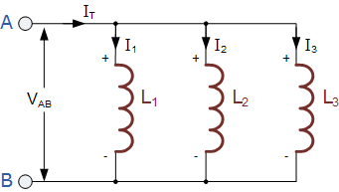
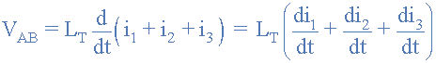
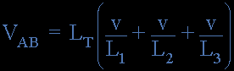
Inductors in parallel
Inductors are said to be connected together in Parallel when both of their terminals are respectively connected to each terminal of another inductor or inductors
The voltage drop across all of the inductors in parallel will be the same. Then, Inductors in Parallel have a Common Voltage across them and in our example below the voltage across the inductors is given as:

Slide 31
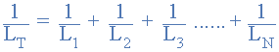
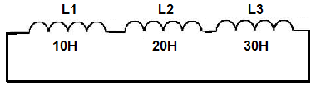
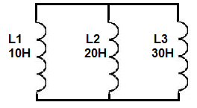
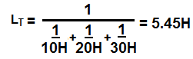
Series and Parallel inductor calculations

Slide 32
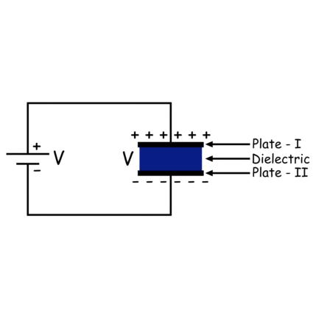
Capacitor
The capacitance is the charge gets stored in a capacitor for developing 1 volt potential difference across it. Hence, there is a direct relationship between the charge and voltage of a capacitor. The charge accumulated in the capacitor is directly proportional to the voltage developed across the capacitor.

Slide 33


Series and Parallel Capacitors
When capacitors are connected in series, the total capacitance is less than any one of the series capacitors’ individual capacitances. If two or more capacitors are connected in series, the overall effect is that of a single (equivalent) capacitor having the sum total of the plate spacings of the individual capacitors. As we’ve just seen, an increase in plate spacing, with all other factors unchanged, results in decreased capacitance.

Slide 34


Parallel Capacitors Equation
Capacitors in Parallel Example No1

Slide 35


Problem on Capacitor in series

Slide 36


Slide 37



Note: This rule can be generalized for any number of resistors in series

Slide 38



Slide 39

Example for Voltage Division Rule

Slide 40


Slide 41

Numerical Problem for Current Division Rule

Slide 42

POLL
I1 = 13.33 A
I1 = 23.33 A
I1 = 6.666 A
I1 = 8.666 A

Slide 44

POLL
R1=2Ω R1=2Ω, R2=4Ω R2=4Ω, R3=1Ω R3=1Ω, Is=5A and VS=4V
Find current at R2?
I1 = 1 A
I1 = 2 A
I1 = 3 A
I1 = 4 A

Slide 45

Example-2 for Current Division Rule

Slide 46


Slide 47




SERIES CONNECTIONS
SERIES CONNECTION: Two or more elements are in series if they exclusively share a single node and consequently carry the same current.

Slide 48

Point to Remember for Series Circuits

Slide 49



PARELLEL CONNECTION
PARALLEL CONNECTION: Two or more elements are in parallel if they are connected to the same two nodes and consequently have the same voltage across them

Slide 50



BATTERY VOLTAGE IN SERIES AND PARALLEL

Slide 51


Slide 52
SOURCES OF ELECTRICAL ENERGY
A Source is a device which converts mechanical, chemical, thermal or some other form of energy into electrical energy. In other words, the source is an active network element meant for generating electrical energy.
The various types of sources available in the electrical network are voltage source and current sources.
Voltage Source and Current Source
A voltage source has a forcing function of emf, whereas the current source has a forcing function of current.

Slide 53


Slide 54


Slide 55


INDEPENDENT SOURCES

Slide 56
Ideal and non ideal (Practical) energy sources

Slide 57

INDEPENDENT SOURCES

Slide 58
Independent Dependent Voltage and Current Source
The source which supplies the active power to the network is known as the electrical source.
The electrical source is of two types namely independent source and dependent source.
The Independent and Dependent source means, whether the voltage or current sources are either depending upon some other source, or they are acting independently.

Slide 59
Independent and Dependent Sources
Independent Voltage and Current Source
Independent sources are that which does not depend on any other quantity in the circuit. They are two terminal devices and has a constant value, i.e. the voltage across the two terminals remains constant irrespective of all circuit conditions.
The strength of voltage or current is not changed by any variation in the connected network the source is said to be either independent voltage or independent current source. In this, the value of voltage or current is fixed and is not adjustable
Dependent Voltage and Current Source
The sources whose output voltage or current is not fixed but depends on the voltage or current in another part of the circuit is called Dependent or Controlled source. They are four terminal devices. When the strength of voltage or current changes in the source for any change in the connected network, they are called dependent sources. The dependent sources are represented by a diamond shape.

Slide 60

DEPENDENT OR CONTROLLED SOURCES

Slide 61



Slide 62


IDEAL AND PRACTICAL VOLTAGE SOURCE

Slide 63



Slide 64



Slide 65

Voltage Controlled Voltage Source (VCVS)
In voltage controlled voltage source the voltage source is dependent on any element of the circuit.

Slide 66


Slide 67


Slide 68


Slide 69

SOURCE TRANSFORMATION
A source transformation is the process of replacing a voltage source V in series with a resistor R by a current source is in parallel with a resistor R, or vice versa.

Slide 70


Source Transformation

Slide 71


SOURCE TRANSFORMATION FOR INDEPENDENT SOURCES
SOURCE TRANSFORMATION FOR DEPENDENT SOURCES
Note: Source transformation also applies to dependent sources, provided, we need to carefully handle the dependent variable

Slide 72


Slide 73

Example for Source Transformation

Slide 74


Which pair of circuits are equivalent?

Slide 75


STAR-DELTA TRANSFORMATION

Slide 76

DELTA-STAR TRANSFORMATION

Slide 77

Example: Delta to Star

Slide 78

Example: Star to Delta

Slide 79


Slide 80





Slide 81






Slide 82





Slide 83

POLL
Calculate Rth
R 3 ohm
R 8 ohm
R 12 ohm
R 16 ohm

Slide 85



Source Transformation

Slide 86








Slide 87






Slide 88





Slide 91

GATE 2014

Slide 92
Nodal Analysis or Nodal Method
Nodal analysis provides a general procedure for analyzing circuits using node voltages as the circuit variables.
Choosing node voltages instead of element voltages as circuit variables is convenient and reduces the number of equations one must solve simultaneously.
Applicable to Nodes only.
It is used to find the unknown node voltages.
This Method is Application of KCL+Ohm’s Law Only

Slide 93
Steps to Determine Node Voltages
1. Select one nodes out of ‘n’ node as the reference node. Assign voltages to the remaining nodes. The voltages are referenced with respect to the reference node.
2. Apply KCL to each of the non-reference nodes. Use Ohm’s law to express the branch currents in terms of node voltages.
3. Solve the resulting simultaneous equations to obtain the unknown node voltages.

Slide 94


selecting a node as the reference or datum node. The reference node is commonly called as ground.
The number of non-reference nodes is equal to the number of independent equations that we have to derive.
Current flows from a higher potential to a lower potential in a resistor.

Slide 95
MESH ANALYSIS
Mesh analysis provides another general procedure for analyzing circuits, using mesh currents as the circuit variables.
Using mesh currents instead of element currents as circuit variables is convenient and reduces the number of equations that must be solved simultaneously.
LOOP” loop is a closed path with no node passed more than once.
MESH: A mesh is a loop that does not contain any other loop within it.

Slide 96
Basic Difference Between Nodal and Mesh Analysis
Nodal analysis applies KCL to find unknown voltages in a given circuit, while mesh analysis applies KVL to find unknown currents.
Mesh analysis is not quite as general as nodal analysis because it is only applicable to a circuit that is planar.
PLANAR CIRCUIT: A planar circuit is one that can be drawn in a plane with no branches crossing one another; otherwise it is nonplanar.
NOTE: A circuit may have crossing branches and still be planar if it can be redrawn such that it has no crossing branches.

Slide 97
SUPERPOSITION THEOREM
If a circuit has two or more independent sources, one way to determine the value of a specific variable (voltage or current) is to use nodal or mesh analysis.
Another way is to determine the contribution of each independent source to the variable and then add them up. The latter approach is known as the superposition.
The idea of superposition rests on the linearity property.

Slide 98
STATEMENT
“The superposition principle states that the voltage across (or current through) an element in a linear circuit is the algebraic sum of the voltages across (or currents through) that element due to each independent source acting alone”.
NOTE: Superposition is not limited to circuit analysis but is applicable in many fields where cause and effect bear a linear relationship to one another.

Slide 99
The principle of superposition helps us to analyze a linear circuit with more than one independent source by calculating the contribution of each independent source separately.
However, to apply the superposition principle, we must keep two things in mind:
1. We consider one independent source at a time while all other independent sources are turned off. This implies that we replace every voltage source by 0 V (or a short circuit), and every current source by 0 A (or an open circuit). This way we obtain a simpler and more manageable circuit.
2. Dependent sources are left intact because they are controlled by circuit variables.

Slide 100
Procedure to Apply Superposition Principle/Theorem
1. Turn off all independent sources except one source.
2. Find the output (voltage or current) due to that active source using any techniques such as Ohm’s Law, KCL, KVL, Nodal/Mesh Analysis etc.
3. Repeat step 1 for each of the other independent sources.
4. Find the total contribution by adding algebraically all the contributions due to the independent sources.

Slide 101


Slide 102


Slide 103

10 mA
20 mA
50 mA
75 mA

Slide 104


Slide 105


Slide 106


Slide 107

100 mA
200 mA
50 mA
75 mA

Slide 108


Slide 109


Slide 110


Slide 111

1 mA
2 mA
7 mA
10 mA

Slide 112


Slide 113


Slide 114


Slide 115








Slide 116





